Slide 1
ITX2000
Autumn 2017 : Coursework 1 Anna Mary Vu
M00650013

Slide 2

Homepage

Slide 3
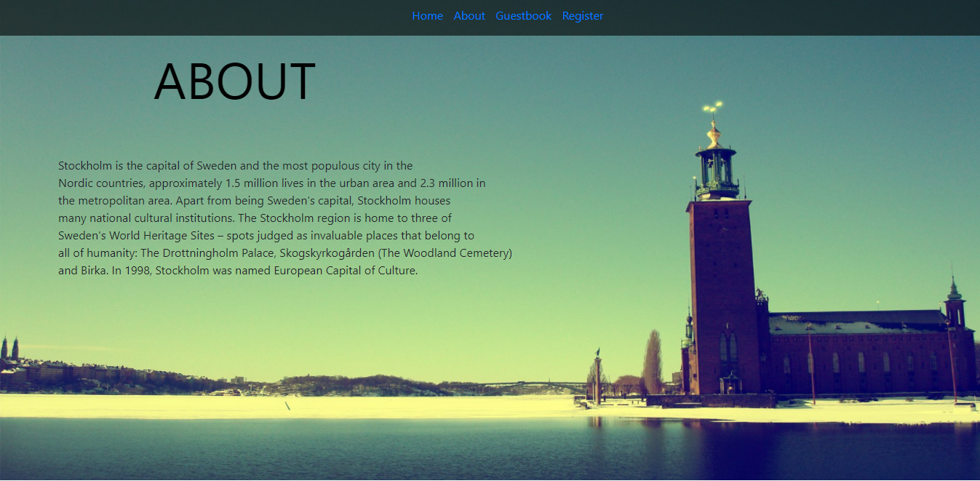
ABOUT

Slide 4
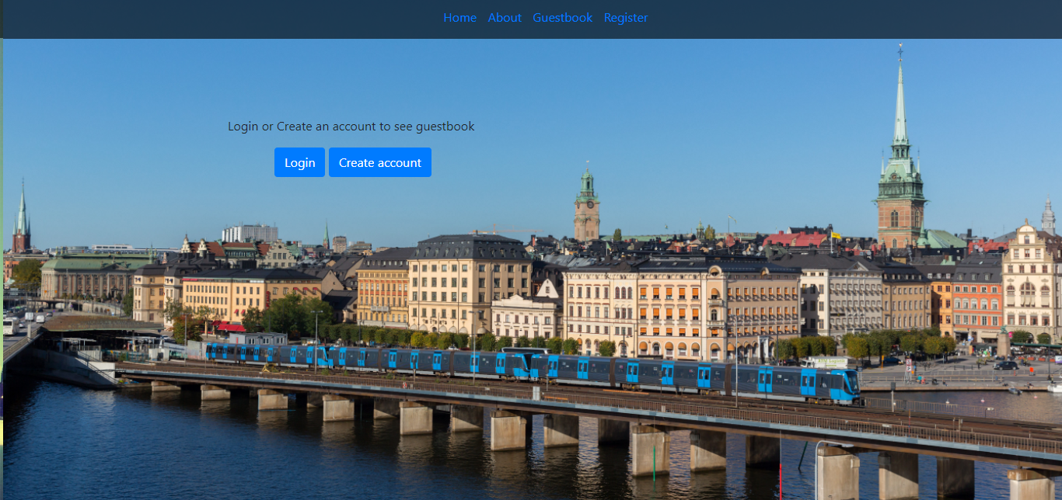
Guestbook not logged in

Slide 5
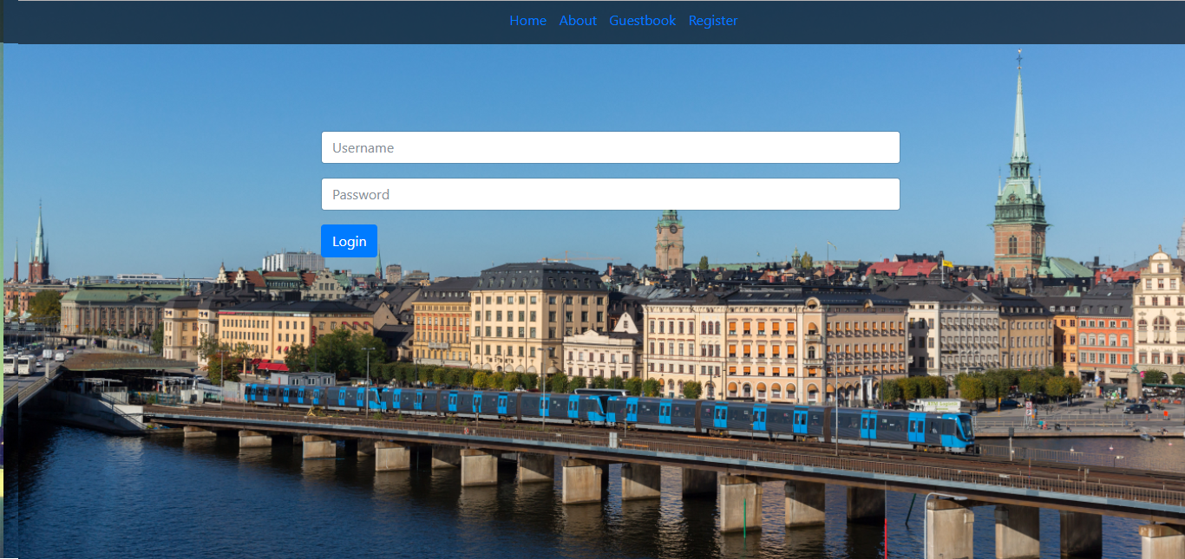
Login page

Slide 6
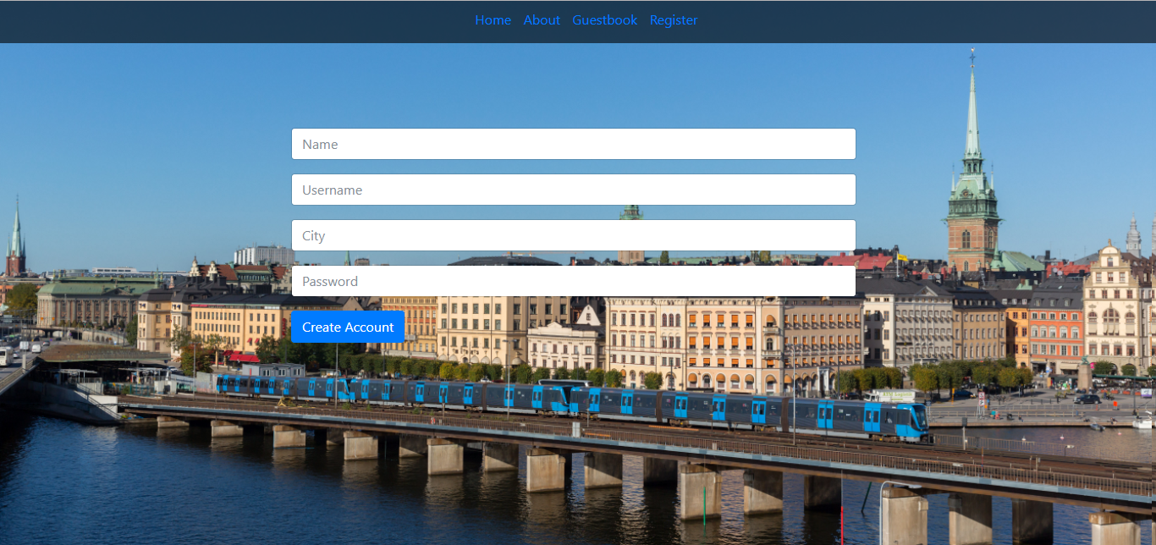
Registration

Slide 7
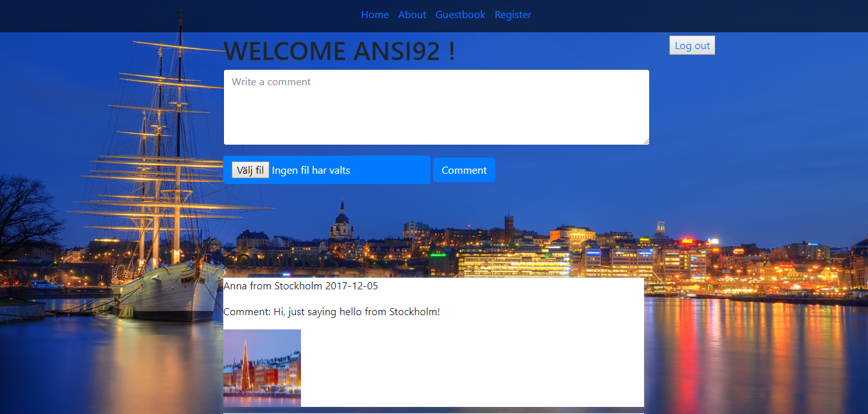
Guestbook logged in

Slide 8
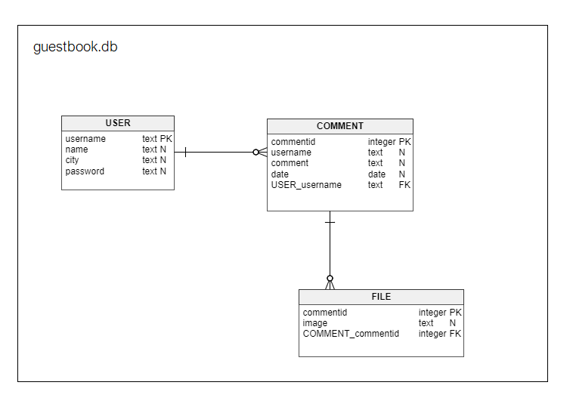
DATABASE MODEL

